Slide 1
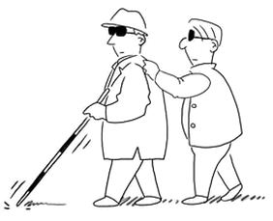
VIRTUAL EYE: A Perfect companion for blind
Aditi 101903527
Riya Singhal 102083026
Raju Kumar Gupta 101953014
Swapnil Kumar Singh 101967003
Mentor : Maninder Singh
CPG number : 180

Slide 2
01
PROBLEM DEFINITION AND SCOPE
02
PROJECT OBJECTIVES
03
LITERATURE SURVEY
04
UML DIAGRAMS
05
ARCHITECTURE DIAGRAM
TABLE OF CONTENTS
06
TOOLS/ PLATFORMS USED
07
ASSUMPTION AND CONSTRAINT
08
METHODOLOGY
09
PROJECT OUTCOMES
10
KEY DELIVERABLES OF THE PROJECT
11
INDIVIDUAL CONTRIBUTION
12
PROFESSIONAL AND TECHNICAL LEARNING

Slide 3
PROBLEM DEFINITION AND SCOPE
Our sense of sight is responsible for most of the information we absorb from our five combined senses and people who get deprived of it face a lot of challenges in life.
In today’s technological age, many applications and technologies are developed to help a visually impaired person but they still continue to struggle.
Although there are many applications developed to help them tackle these challenges, but they are still not up to mark in terms of usability, user friendliness, convenience and other factors.
Thus, we aim to develop an application which provides basic necessary functionalities with user friendly interface by removing their dependence on visual elements of application.

Slide 4
PROJECT OBJECTIVES
Object Detection
To detect all objects in the surroundings
To detect specific objects in the surrounding
Text-to-Speech Conversion
To scan text from documents and convert to speech
To scan text from environment and convert to speech
Navigation through path
To identify obstacles
To send the distance to the user in speech form
Voice Assistant
To control and use the application through voice commands
To send every information to user through

Slide 5
LITERATURE SURVEY
TapTapSee is designed to help the blind and visually impaired identify objects they encounter in their daily lives. But it had a really poor user interface which is hard to understand , has poor accuracy and takes a long processing time (around 15 seconds to one minute).
Envision AI is a app that speaks out the visual world, helping blind and visually impaired users.. The proposed system suffered some flaws, like it is not able to find people, objects or scan barcodes maximum no. of times. Also, it’s user interface requires a person to read, view and touch screen. Also, it is a paid software.
Supersense is also another application developed by Mediate, an MIT-spinoff AI start-up based in Boston, to help the blind people. It’s speed of text-to-speech conversion is very fast making it difficult to interpret and also it can’t locate documents in phone’s local storage.
2017
2019
2013
2017
2021
Seeing AI is a application developed by Microsoft to help the blind people by narrating the world around them. This application had a really good guiding system for taking pictures or scanning documents and works well except for the fact that it is made to be used only by IOS users. Also, it has an issue of draining a lot of battery.
Lookout is an application developed by Google to help the blind people. It has flaws like: in object detection, it has really poor accuracy , it reads out instructions in very fast speed which is difficult to interpret, and it reads out words in random order, and mixes up the sentences making everything fussy while reading text as audio message..
Notes:
Taptapsee was developed in 2013 .it had poor user interface and a long processing time Envision AI was developed in 2017 ,it can’t detect objects and barcodes maximum no. of times and its user interface is such that one should read it which is not possible for the blind Lookout was developed by google in 2019 but had issues in object detection, and a very high speed of text to speech conversion making it difficult to interpret Supersense was also another app with similar disadvantages

Slide 6
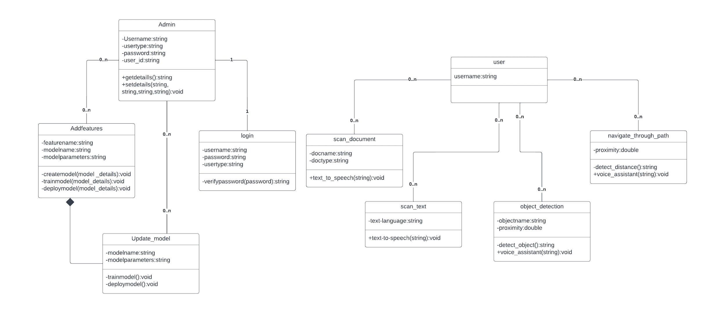
CLASS DIAGRAM
Most content on social media or other sites in not just textual, but in audio or audio visual form. Can extract users’ opinion or sentiment towards a product, post, policy, event etc when we only have their voice as input, like podcasts, radios.
Notes:
Class diagrams are the blueprints of our system which are used to model the objects that make up the system, to display the relationships between the objects, and to describe what those objects do and what services they provide.

Slide 7
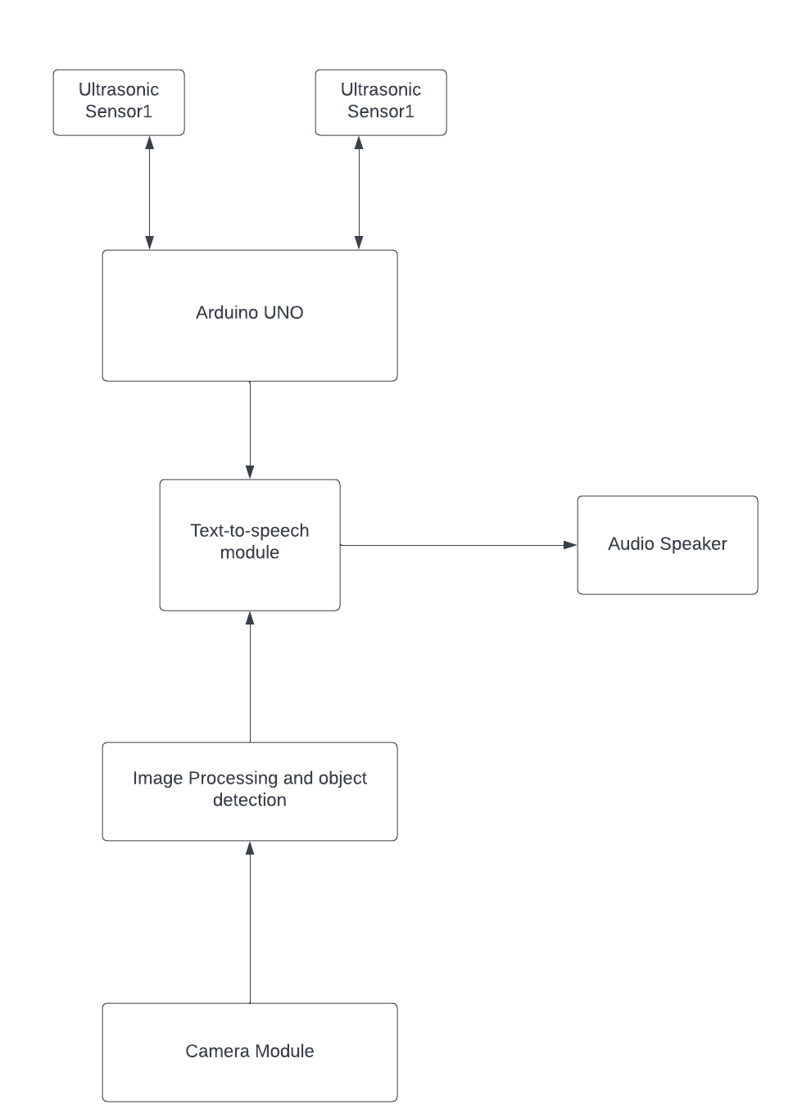

ARCHITECTURE DIAGRAM
Notes:
A simple architecture diagram (UML) helps system designers and developers visualize the high-level structure of their system or application to ensure it meets their users' needs. It can also help describe patterns that are used throughout the design.

Slide 8
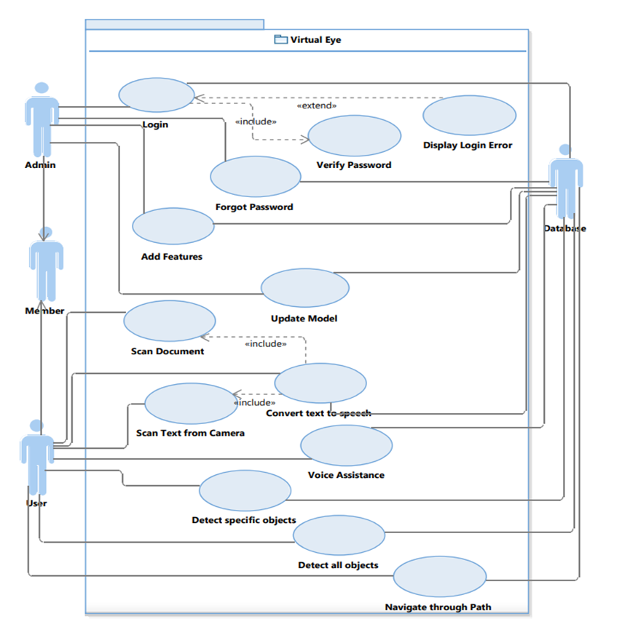
USE CASE DIAGRAM
Notes:
This is the use case diagram for our application to show various users and their interaction with the system. We have 2 type of users the admin who is responsible for managing, developing and monitoring the application and the other is users which are currently intended to be visually impaired people. The admin

Slide 9
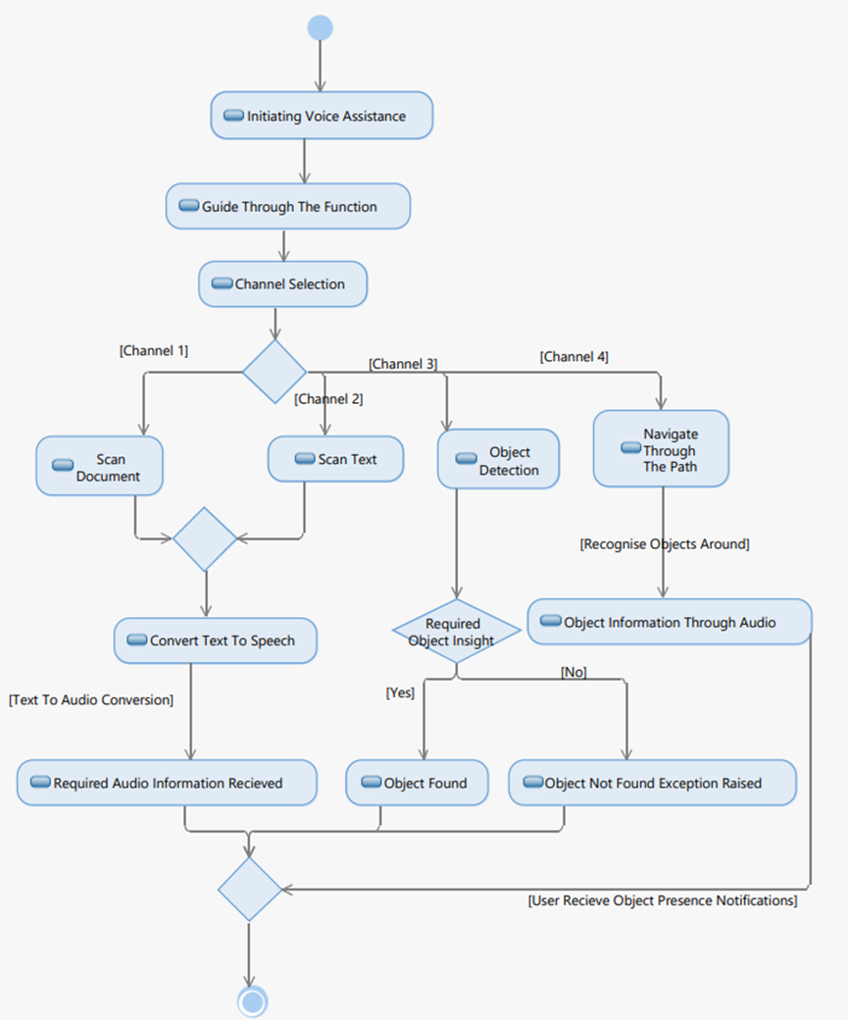
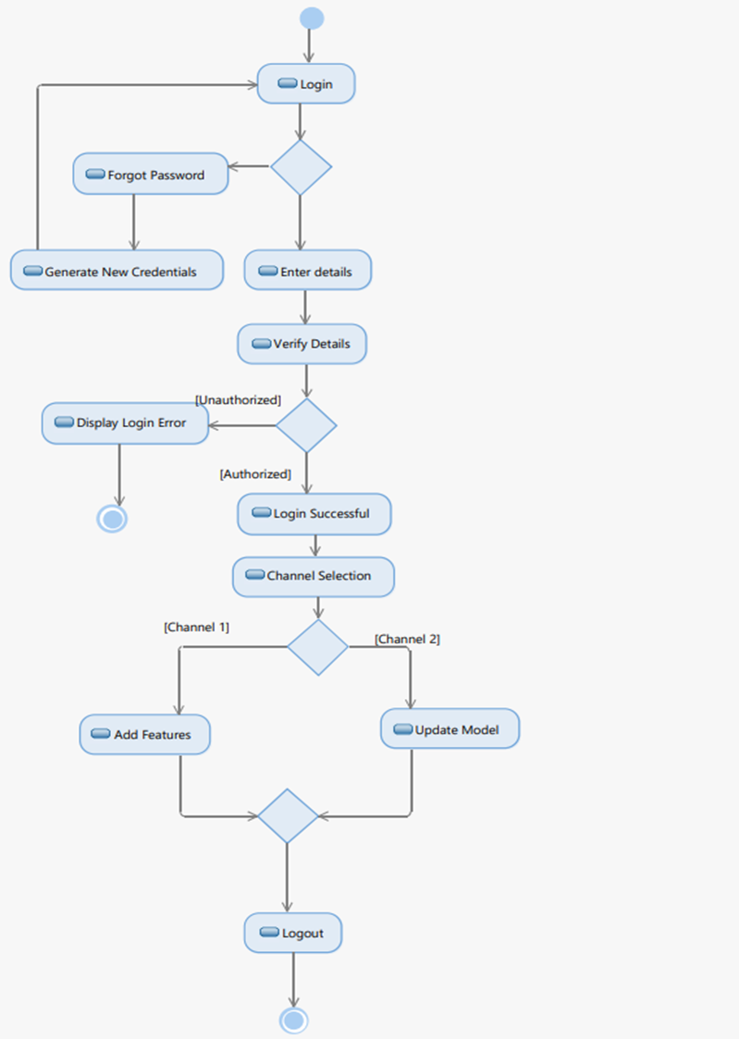
ACTIVITY DIAGRAM
Activity Diagram for “User”
Activity Diagram for “Admin”

Slide 10
Tools/Platforms Used
01
Alan AI
To interface user with application through voice commands
02
Google ML kit
To perform text recognition
03
Android studio IDE
To create our android application
04
Flutter
To develop our application (Android development language)
05
Tflite package
To perform object detection
06
Arduino UNO Wifi Rev2
To initiate connection between application and Arduino

Slide 11
ASSUMPTIONS
CONSTRAINTS
User must not audibly impaired.
User must be comfortable in speaking and listening english.
User must have decent internet connectivity for making use of functionalities .
User must have a access to a smartphone.
User must hold the stick to use navigate through path module.
The system will only support english language for voice communication.
The system will need a good internet connection for features to execute.
The object detection functionality limits objects distance to a specific range.
The text being scanned must be clear.
The quality of internal camera must be good for both text detection and object detection.

Slide 12
METHODOLOGY
For the stick used for navigating through path, we would use ultrasonic sensor for detecting distance from obstacles present at a distance less than one meter and would send it to app using Wi-Fi module and the Alan voice assistant would be used to send the information to the user in voice format.
Object detection module which is used to find/spot a specific object in the environment, identify all objects being captured in the environment, is built using the tflite package and a pre-trained SSD-Mobile Net model.
Recognition of text from image or document is done using ML kit of google firebase

Slide 13
PROJECT OUTCOMES
Scan images convert its text to speech and real aloud to the user
Navigation though path
Text detection
Identify obstacles in the path and tell user
Detecting all object in the surroundings and finding specific object
Control the app using voice commands and can interact with the assistant
Integration of all the previous modules in the base flutter app
Object detection
Voice based Assistant
BASIC FLUTTER APP

Slide 14
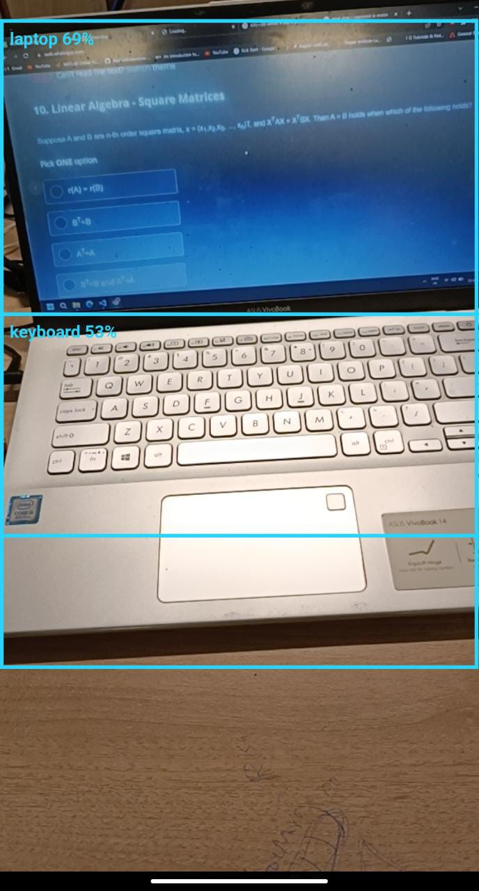
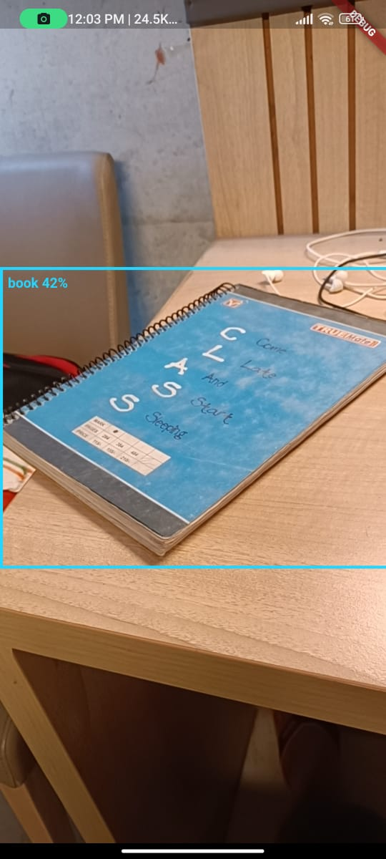
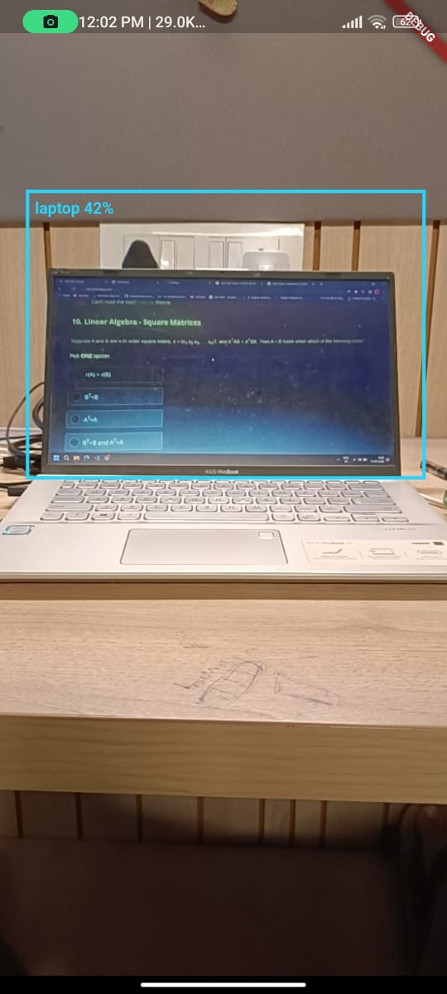
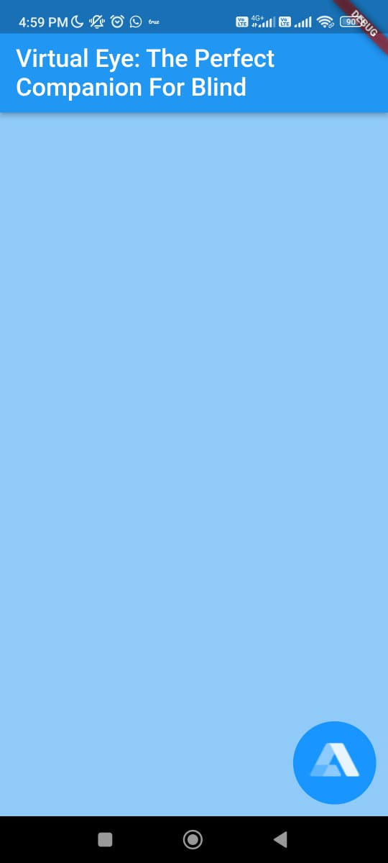

Slide 15
KEY DELIVERABLES OF THE PROJECT
The user’s speech in real-time will be heard by an emotionally intelligent bot in real-time.
.User would be able to find all objects in his/her surroundings as well as he/she could focus on finding a specific object also.
The application can help the user in reading soft copies present in his/her phone’s local storage.
The application would also help user in reading text present in the user’s surroundings like: a hoarding board etc.
The user’s speech would be heard in real-time and be used as a command to navigate through various options in the application.
The user would get every output or instruction in audio format.

Slide 16
INDIVIDUAL CONTRIBUTIONS
Riya Singhal
Swapnil kumar Singh
Raju kumar Gupta
Aditi
Report preparation.
Research. Module
building
Report preparation.
Research. Module building.
Report preparation. Research. Module building.
Report preparation.
Research. Module building.Integration of Modules.

Slide 17
PROFESSIONAL AND TECHNICAL LEARNING
Through this project we learnt various Computer Science concepts like -
Machine learning- We used a pre-trained ssd_mobilenet model learned how a pre-trained model works, how to use it and integrate with an outside application.
Mobile Application development-To create the base mobile Application we used flutter learned the dart programming language.
Voice Assistant - Alan Ai we learned how its functions and how it is integrated with other applications.

Slide 18
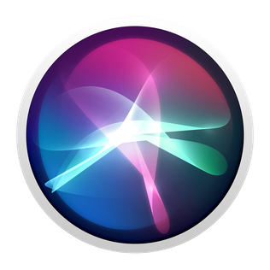
THANK YOU
Aditi 101903127
Riya Singhal 102083026
Raju Kumar Gupta 101953014
Swapnil Kumar Singh 101967003

